Slide 1
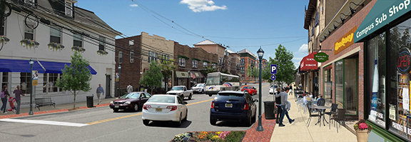
Opportunity Zone Strategic Planning

Slide 2
Why Plan?
Coordinates and facilitates municipality’s efforts to attract businesses, development, and investment
Allows for municipality to align investment activity with local priorities
Developing housing and employment opportunities for residents
Helps connect local community, small and MWBE businesses with flows of outside capital
Helps target appropriate development in the appropriate areas
Leverages stakeholder partnerships to get the most local benefit out of the program

Slide 3
SETTING PRIORITIES
Prioritizing OZ neighborhoods
Increased code enforcement and law enforcement presence in targeted areas
Development and redevelopment priorities for Opportunity Zones
Vacant sites, abandoned buildings targeted for redevelopment

Slide 4
Setting priorities
Identifying key priority projects
Shovel ready” but without a developer or sufficient capital to get off the ground
Projects that are ready for investment
Opportunity Zone investments generally must occur before the end of 2019
Projects where there’s willingness to support with local tax incentives if necessary
Projects that work well with Opportunity Zones (taxable capital gains involved)
Work with county, local agencies, anchor institutions, and community development partners to identify these projects
Examining Areas in Need of Redevelopment – removing old and obsolete ones
Focusing on priority areas
Creating new ones

Slide 5
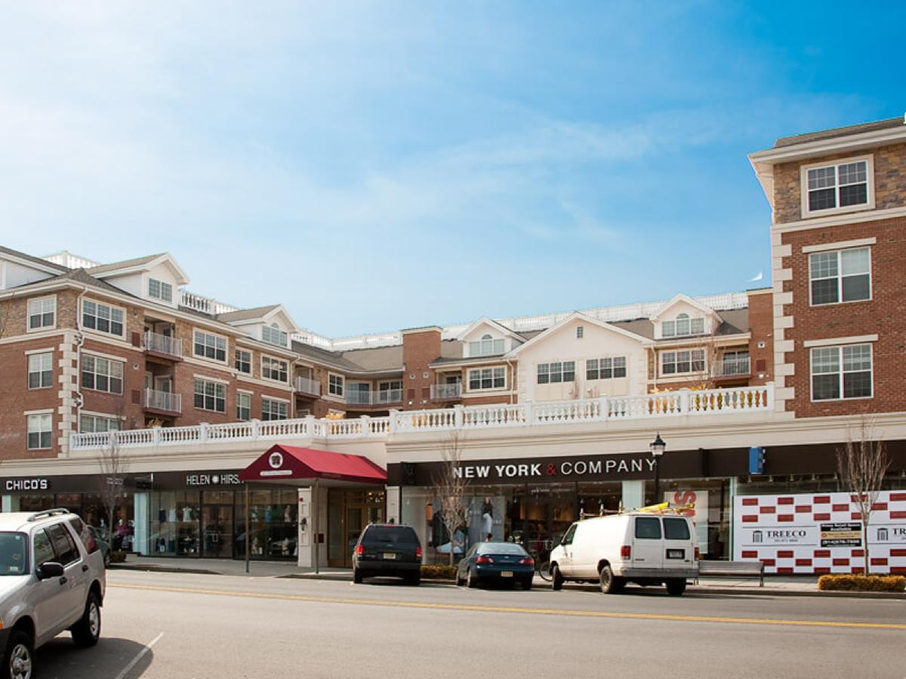
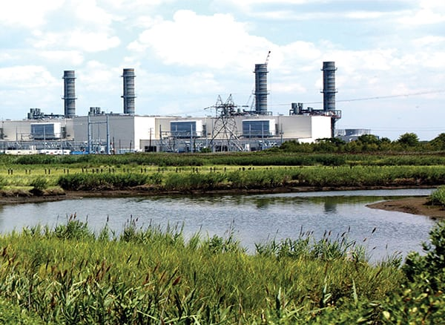
Building on neighborhood strengths
Strategic focus on investments by neighborhood character
Small businesses and mixed-use
developments in commercial corridors,
downtowns
Affordable housing in residential
neighborhoods
Transportation, warehousing,
and logistics in industrial area -
areas close to highways, railyards airports,
and other transportation links
Neighborhoods with existing state and local
development incentives
Avoiding projects with negative
neighborhood impacts in residential areas
Waste management facilities
Landfills
Chemical manufacturing and processing

Slide 6
Development impacts
Develop strategies to deal with development impacts
Infrastructure improvements from new development (i.e. roads, highways, streetscapes)
Funding through impact fees and charges
Impact on schools (new students from residential development)
School improvements and expansion
Impact fees
Developers contribute to the additional cost of municipal services and infrastructure from development
Preservation and expansion of affordable housing
Inclusionary zoning – mitigate effects of gentrification
Contributions to an Affordable Housing Trust Fund
Parking
Transit access
Working with NJ Transit to improve and expand access

Slide 7
Promoting your community
Develop a marketing strategy to sell your Opportunity Zones to businesses, investors, and developers
Investment prospectuses that highlight community assets and economic strengths
Promote projects with excellent potential for attracting investment
Emphasize potential return on investment for investors, how Opportunity Zone projects could yield a better return than others
Link marketing efforts to community development goals and strategies

Slide 8
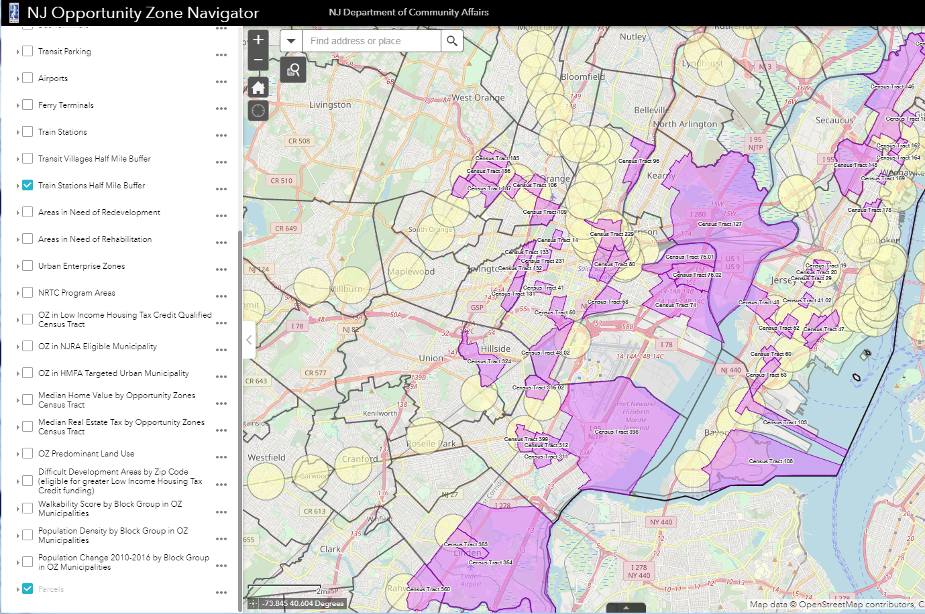
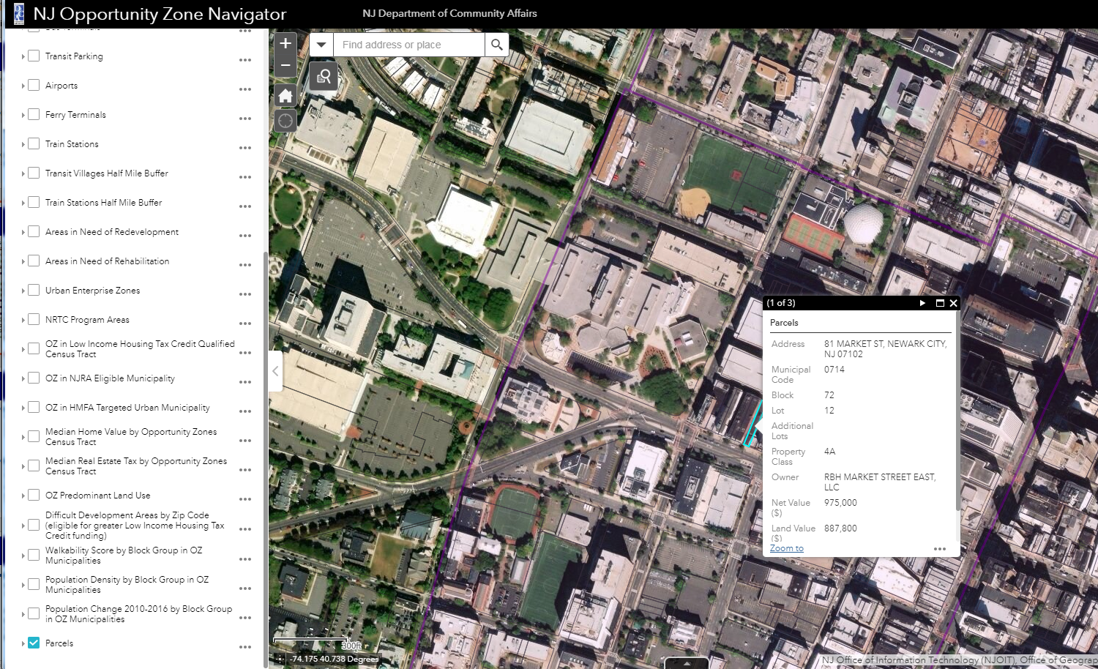
Promoting your communiTy
Use the DCA community asset map to help promote your community
Identify and highlight community assets
Schools, colleges, hospitals, parks, transit access, walkability, etc.
Identify special state development incentive areas that are attractive to investors
Urban Enterprise Zones
Neighborhood Revitalization Tax Credit
Gather information on vacant parcels, property values, and ownership to pitch specific properties to investors
Highlight local redevelopment areas

Slide 9
Planning and coordinating
Interdepartmental planning and coordination
Interdepartmental meetings to discuss and coordinate OZ priorities and strategy. Include all local departments and agencies that are involved in authorizing business and development activity
For example, community development, economic development, planning and zoning, codes and construction departments
Designating Opportunity Zone coordinators
Liaison to engage with businesses and developers
Engage with local community members, community organizations and non-profits
Provide local resources for Opportunity Zone development
Answer questions about development opportunities and the approval process

Slide 10
Building partnerships
Build partnerships with local institutions
Anchor institutions (i.e. colleges, universities, hospitals)
Community and non-profit organizations (i.e. neighborhood associations, community development corporations, community development financial institutions, local foundations)
Build partnerships with neighboring municipalities
Develop regional investment prospectuses that communicate the region’s economic strengths and advantages
Joint marketing efforts
Advance large OZ projects that cross municipal boundaries
Information and best practices sharing
Coordinate engagement of investor and businesses communities

Slide 11
Regional cooperation
Cooperating with other local governments
For example, county government, surrounding municipalities
Develop regional investment prospectuses that communicate the region’s economic strengths and advantages
Advance large OZ projects that cross municipal boundaries
Information and best practices sharing
Coordinate engagement of investor and business communities

Slide 12
Creating a plan
Develop a local opportunity zones plan
Roadmap for achieving positive outcomes in your Opportunity Zones
Documents all planned activities with timelines
Identifies local priorities for development in zones
Outlines a detailed local strategy for attracting investment and community engagement
Establishes framework for evaluation and review

Slide 13
State Assistance
The State of New Jersey stands ready to support your efforts to promote equitable and inclusive development within your Opportunity Zones
Feel free to reach out to the State if you need assistance:
njopportunityzones@dca.nj.gov

